Slide 1
Gestalt Therapy Theory
El Schoepf, M.S. - APPL 605

Slide 2

Roadmap
Major figures & historical context
Gestalt principles
  Phenomenology
  “Psychopathology,” or creative adjustment
  Contact (& contact disturbances)
  Experiment & “Safe Emergency”
Activity: 4 Corners of Dialogue

Slide 3
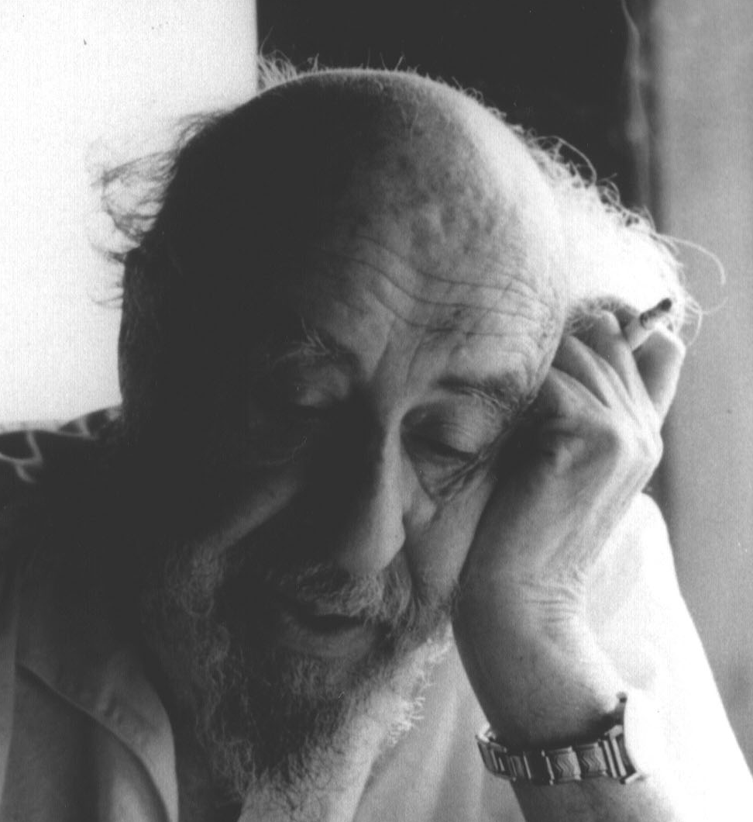
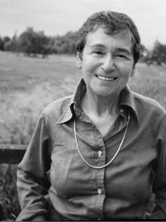
Major Figures, Historical Context
1920s Europe → 1933 South Africa → 1945 NYC
Fritz Perls
  psychiatrist
  trained in psychoanalysis with Karen Horney & Wilhelm Reich
Lore (Laura) Perls
  psychologist
  trained in philosophy with Heidegger & Gestalt psychology with Max Wertheimer
Nazi Germany, humanism, dynamics of oppression
Fritz Perls therapy with Gloria: https://www.youtube.com/watch?v=it0j6FIxIog

Slide 4
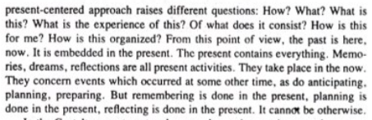
Phenomenology
Not interested in the “objective” or “expert” viewpoint
Can only be experienced in the “here and now”
Help client build capacity for physical awareness
Nevis, 1996, p. 17

Slide 5
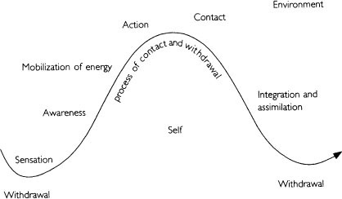
Theory of Psychopathology
Creative adjustment
The “contact cycle”
Notes:
creative adjustment is a non-pathologizing stance. In psychoanalysis, the analyst tells the ct what the dream means. Gestalt therapists are more interested in what the dream means to the CLIENT.

Slide 6
Disturbances to true contact
Projection: distorting understanding of self and other by attributing disowned parts of self to another or the environment
  Tx: Identifying and “owning” disowned parts of self
Introjection: taking in ideas passively
  Tx: Dislodging and critically examining “introjects”
Retroflection: titrating; turning an impulse inward
  Tx: rediscovering the original impulse and expressing it in a healthy way
Deflection: avoiding direct contact
  Tx: Learning to experience contact with adequate support (from therapist)
Confluence: prematurely accepting (or demanding) sameness with/from others
  Tx: Experiencing confluence/nonconfluence and creating situations where the client can choose

Slide 7

Interventions, or “Experiments”
“safe emergency”
Content of what happens in therapy
Therapist must pay attention
  “grading up and grading down” difficulty
  Willingness to abandon one experiment for another

Slide 8
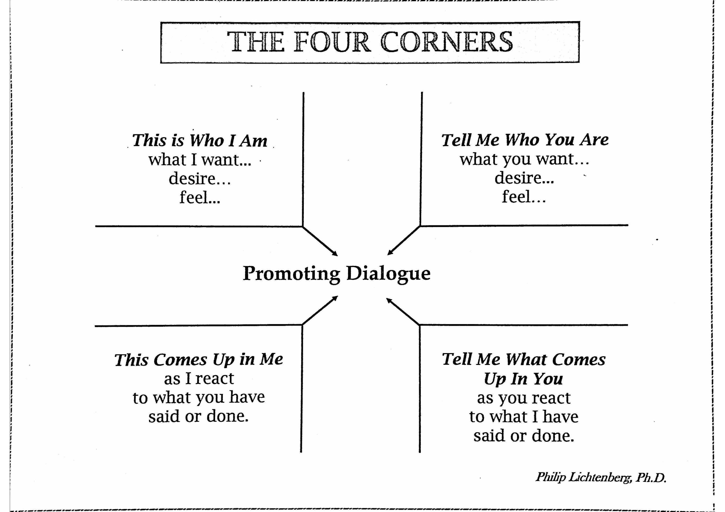
4 Corners of Dialogue

Slide 9
Additional Resources
Polster, E. & Polster, M. (1973) Gestalt Therapy Integrated. New York. Random House.
Perls, F., Hefferline, R. & Goodman, P. (1994 edition) Gestalt Therapy Excitement and Growth in the Human Personality. Gouldsboro, ME. The Gestalt Journal Press.
Dreitzel, H. P. (2010) Clinical Diagnosis in Gestalt Therapy: A Field Guide. Berlin, Germany: EHP.
Taylor, M. (2014) Trauma Therapy and Clinical Practice: Neuroscience, Gestalt and the Body. Maidenhead, UK. Open University Press
Woldt, A. & Toman, S. (Eds.) (2005) Gestalt Therapy, History, Theory and Practice. Thousand Oaks, CA. Sage Publications.

